Slide 1
CS 4530: Fundamentals of Software Engineering Module 3, Lesson 1 Web Applications
Rob Simmons
Khoury College of Computer Sciences

Slide 2
Learning Goals for this Lesson
At the end of this lesson, you should be able to
Explain the role of “client” and “server” in the context of web application programming
Explain the primary options for client-server communication
Identify places where TypeScript does — and doesn’t! — help with writing correctly-behaving web applications, and identify some of the solutions to functionality TypeScript doesn’t provide

Slide 3






So, software engineering must encompass:
PEOPLE
PROCESSES
PROGRAMS
PLANNING
We’re gonna be stuck over here for a bit.
ORGANIZING
implementing

Slide 4
Web Applications are Distributed Systems
Distributed systems are hard!
Web applications are designed to only be kinda difficult-to-build distributed systems
Most of this lecture is bad advice if you’re Google, Netflix, or Amazon
Web applications are distributed systems because
You don’t live in the cloud
Scalability: Netflix needs at least two computers

Slide 5
An Insultingly Shallow Intro to Networking
SERVER
(a program running on a computer in a data center somewhere)
CLIENT
(a web browser running in a consumer operating system on a consumer device)
internet

Slide 6

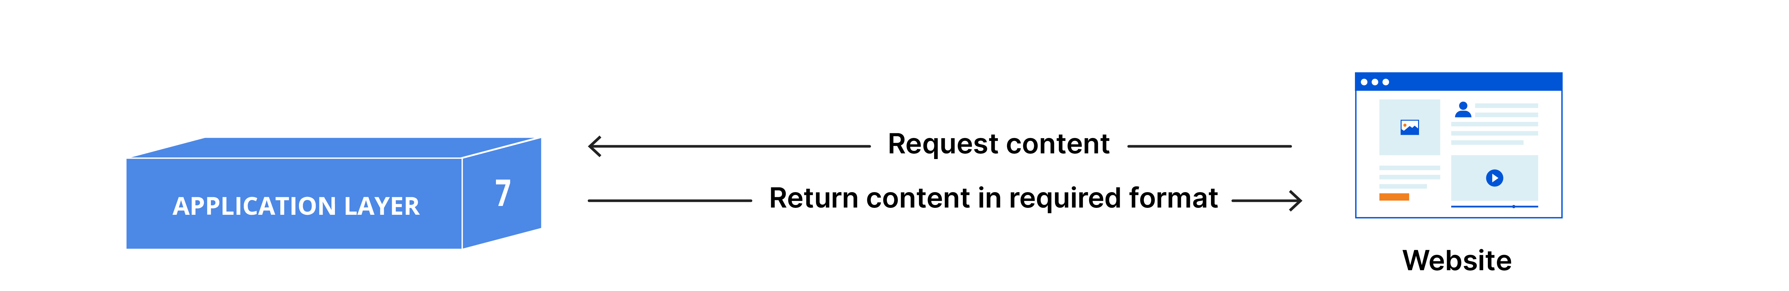
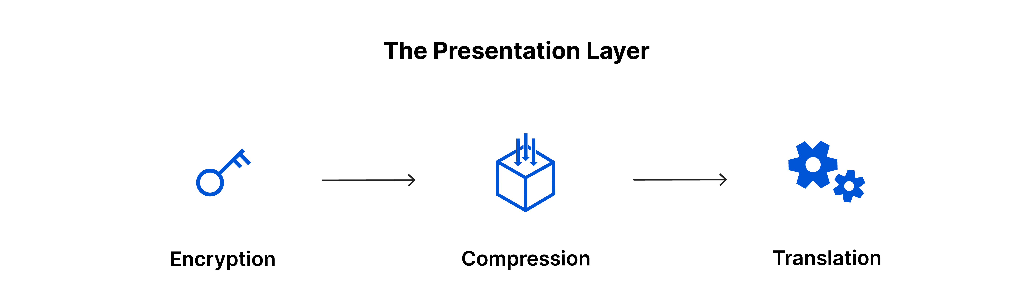
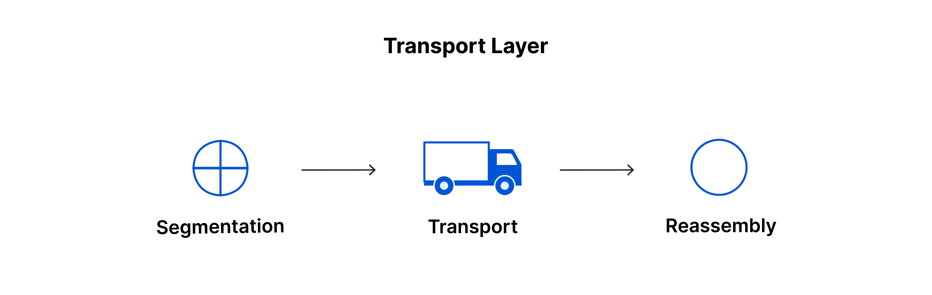
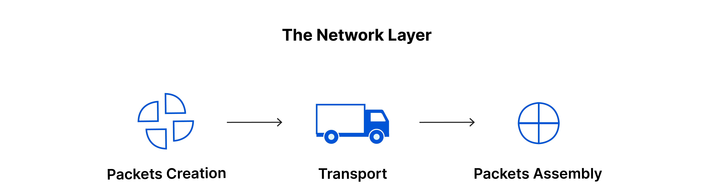
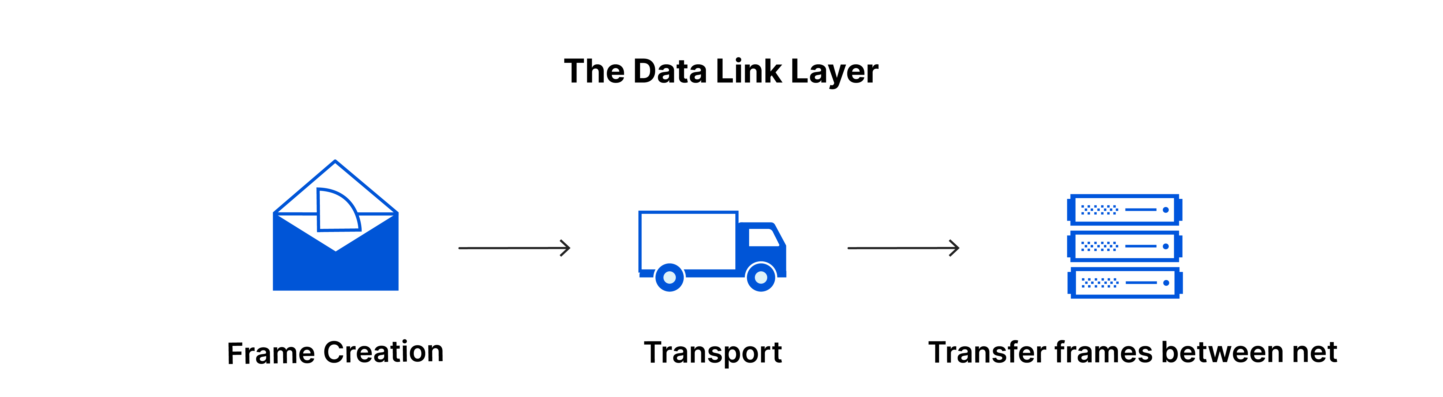
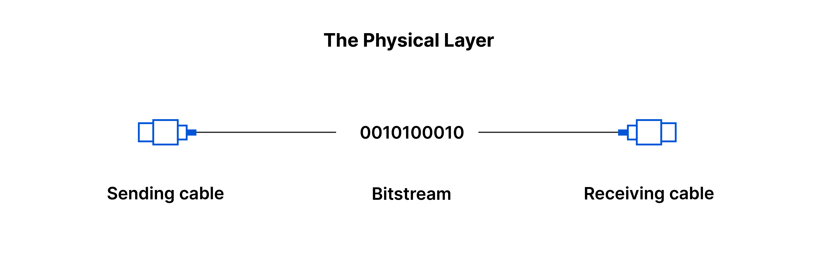
An Insultingly Shallow Intro to Networking
SERVER
(a program running on a computer in a data center somewhere)
CLIENT
(a web browser running in a consumer operating system on a consumer device)
https://www.cloudflare.com/learning/ddos/glossary/open-systems-interconnection-model-osi/
Notes:
There’s a whole enormous stack of technology used to connect the physics of electronic communication to the goal of streaming Severence on Apple TV. Stuff like “OSDI model of networking” and you can take a course like CS 4700 to actually learn about that.

Slide 7
An Insultingly Shallow Intro to Networking
SERVER
(a program running on a computer in a data center somewhere)
CLIENT
(a web browser running in a consumer operating system on a consumer device)
Transport Layer
TCP you may have heard of
UDP you don’t need for this class
QUIC is new
Key abstraction: sending a message
https://www.cloudflare.com/learning/ddos/glossary/open-systems-interconnection-model-osi/
Notes:
What is worth understanding is that there are more-or-less leaky abstractions at play, but “sending a single message” at the transport layer is a pretty stable one. Most of you will never have to think about how networks send a single message in the same way you’ll never need to understand how chips implement an instruction set architecture.

Slide 8
Application Layer Abstractions
Remote procedure calls happen via HTTP requests (REST)
GET /
ok here you go (status 200, payload <!doctype html><html lang=“en…)
SERVER
(a program running on a computer in a data center somewhere)
CLIENT
(a web browser running in a consumer operating system on a consumer device)
GET /favicon.svg
ok here you go (status 200, payload <svg width="450" height="450" viewBox="…)
POST /api/user/login, payload {"username":"user1","password":”password"}
ok here you go (status 200, payload {"error":"Invalid username or password"})
Notes:
The top level is called the “application” layer, but it’s still a ways away from streaming Severance on Apple TV. HTTP is at the application layer. For the purposes of our discussion, it consists of pairs of request-and-response messages.
DEMO TIME — actually look at these in the network menu

Slide 9
Application Layer Abstractions
Message Passing happen via WebSockets
I would like to join this chatroom ["chatJoin",{"auth":{"username":"rob",”pass…)
SERVER
(a program running on a computer in a data center somewhere)
CLIENT
(a web browser running in a consumer operating system on a consumer device)
i got u ["chatJoined",{"_id":"68112e17c5df6e25e2c0a2c7","messages":[{"_id":"68136f9ac5df…)
hey someone joined chat ["chatUserJoined",{"user":{"username":”tim”, “display”:”T…)
hey someone joined chat ["chatUserJoined",{"user":{"username":”bo”, “display”:”Ro…)

Slide 10
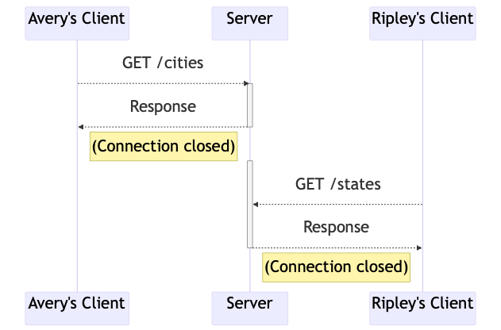
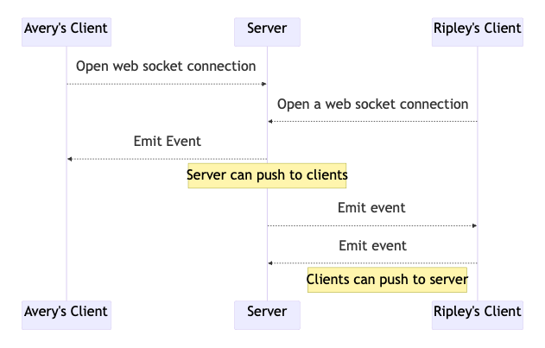
Application Layer Abstractions
REST
Web Sockets
Notes:
<edit this at: >
https://mermaid.ink/img/pako:eNqFkUFrAjEQhf_KEBBbUASPOQjFlp560R5zSZNZDWQn28xEEPG_N9tYaK20OU1mvnnz4J2USx6VVozvBcnhY7C7bHtDUN9kArZIotK_YW6twWYJLgyWBBxYhocD5uOUYR0DkvyGeIS2mCsGNySW43gThojXIg7m89UKWMPz0yssXJCA3EbWSThYQbj8uaFOwwZ5SMTY-h6vSUq1jtgJpG6UvlsnIqxQInAxMfp7Q7ePVKs_DLHUIX_RzYJb_m_hm5Ecdvs_nKiZ6jH3Nvga0GncM0r22KNRupYeO1uiGGXoXNExqe2RnNKSC85UGXy9eslT6c5Grl30QVJ-aaF_Zn_-AHpDpwY?type=png)](https://mermaid.live/edit#pako:eNqFkUFrAjEQhf_KEBBbUASPOQjFlp560R5zSZNZDWQn28xEEPG_N9tYaK20OU1mvnnz4J2USx6VVozvBcnhY7C7bHtDUN9kArZIotK_YW6twWYJLgyWBBxYhocD5uOUYR0DkvyGeIS2mCsGNySW43gThojXIg7m89UKWMPz0yssXJCA3EbWSThYQbj8uaFOwwZ5SMTY-h6vSUq1jtgJpG6UvlsnIqxQInAxMfp7Q7ePVKs_DLHUIX_RzYJb_m_hm5Ecdvs_nKiZ6jH3Nvga0GncM0r22KNRupYeO1uiGGXoXNExqe2RnNKSC85UGXy9eslT6c5Grl30QVJ-aaF_Zn_-AHpDpwY

Slide 11
Implementing REST APIs
“Express” is good for implementing servers in NodeJS
SERVER
(a program running on a computer in a data center somewhere)
POST /api/user/login, payload {"username":"user1","password":”password"}
ok here you go (status 200, payload {"error":"Invalid username or password"})
CLIENT
import express from 'express’;
let numLogins = 0;
const app = express();
app.use(express.json());
app.post('/api/user/login', (request, response) => {
const { username, password } = request.body;
if (username.toLowerCase() === 'user1' && password === 'sekret') {
response.send({ success: true, numLogins: numLogins++ });
} else {
response.send({ error: 'Invalid username or password' });
}
});
Notes:
DEMO TIME — actually look at these in the network menu

Slide 12
Implementing REST APIs
The “any” type and “as” are common in TypeScript
SERVER
(a program running on a computer in a data center somewhere)
POST /api/user/login, payload {"username":"user1","password":”password"}
ok here you go (status 200, payload {"error":"Invalid username or password"})
CLIENT
import express from 'express’;
let numLogins = 0;
const app = express();
app.use(express.json());
app.post('/api/user/login', (request, response) => {
const { username, password } = request.body;
if (username.toLowerCase() === 'user1' && password === 'sekret') {
response.send({ success: true, numLogins: numLogins++ });
} else {
response.send({ error: 'Invalid username or password' });
}
});
creators of the express types chose to make this type “any”

Slide 13
Implementing REST APIs
TypeScript: looks good!
ESLint: “unsafe assignment of any value”
The “any” type and “as” are common in TypeScript
SERVER
(a program running on a computer in a data center somewhere)
POST /api/user/login, payload {"username":"user1","password":”password"}
ok here you go (status 200, payload {"error":"Invalid username or password"})
CLIENT
import express from 'express’;
let numLogins = 0;
const app = express();
app.use(express.json());
app.post('/api/user/login', (request, response) => {
const { username, password } = request.body;
if (username.toLowerCase() === 'user1' && password === 'sekret') {
response.send({ success: true, numLogins: numLogins++ });
} else {
response.send({ error: 'Invalid username or password' });
}
});
creators of the express types chose to make this type “any”

Slide 14
Implementing REST APIs
TypeScript: looks good!
ESLint: looks good!
The “any” type and “as” are common in TypeScript
SERVER
(a program running on a computer in a data center somewhere)
POST /api/user/login, payload {"username":"user1","password":”password"}
ok here you go (status 200, payload {"error":"Invalid username or password"})
CLIENT
import express from 'express’;
type UserAuth = { username: string; password: string };
let numLogins = 0;
const app = express();
app.use(express.json());
app.post('/api/user/login', (request, response) => {
const { username, password } = request.body as UserAuth;
if (username.toLowerCase() === 'user1' && password === 'sekret') {
response.send({ success: true, numLogins: numLogins++ });
} else {
response.send({ error: 'Invalid username or password' });
}
});

Slide 15

Implementing REST APIs
Anyone can send an HTTP request containing anything
SERVER
(a program running on a computer in a data center somewhere)
POST /api/user/login, payload {”lol":[”owned”],”password":4,”note”:”loser”}
???
import express from 'express’;
type UserAuth = { username: string; password: string };
let numLogins = 0;
const app = express();
app.use(express.json());
app.post('/api/user/login', (request, response) => {
const { username, password } = request.body as UserAuth;
if (username.toLowerCase() === 'user1' && password === 'sekret') {
response.send({ success: true, numLogins: numLogins++ });
} else {
response.send({ error: 'Invalid username or password' });
}
});

Slide 16
Implementing REST APIs
Uncaught TypeError: username.toLowerCase is not a function
Anyone can send an HTTP request containing anything
SERVER
(a program running on a computer in a data center somewhere)
POST /api/user/login, payload {”lol":[”owned”],”password":4,”note”:”loser”}
i have no idea what is going on (500 Internal Server Error)
import express from 'express’;
type UserAuth = { username: string; password: string };
let numLogins = 0;
const app = express();
app.use(express.json());
app.post('/api/user/login', (request, response) => {
const { username, password } = request.body as UserAuth;
if (username.toLowerCase() === 'user1' && password === 'sekret') {
response.send({ success: true, numLogins: numLogins++ });
} else {
response.send({ error: 'Invalid username or password' });
}
});

Slide 17
Implementing REST APIs
Throws an error if the input is unexpected (safeParse is the non-exception-raising option)
import express from 'express';
import { z } from 'zod';
type UserAuth = { username: string; password: string };
const zUserAuth = z.object({
username: z.string(),
password: z.string(),
});
let numLogins = 0; const app = express();
app.use(express.json());
app.post('/api/user/login', (request, response) => {
const { username, password }: UserAuth = zUserAuth.parse(request.body);
if (username.toLowerCase() === 'user1' && password === 'sekret’) {
response.send({ success: true, numLogins: numLogins++ });
} else {
response.send({ error: 'Invalid username or password' });
}
});
Notes:
It’s generally a bad idea

Slide 18


Implementing REST APIs
import express from 'express’;
import { z } from 'zod’;
type UserAuth = z.infer<typeof zUserAuth>;
const zUserAuth = z.object({
username: z.string(),
password: z.string(),
}); let numLogins = 0; const app = express();
app.use(express.json());
app.post('/api/user/login', (request, response) => {
const { username, password }: UserAuth = zUserAuth.parse(request.body);
if (username.toLowerCase() === 'user1' && password === 'sekret') {
response.send({ success: true, numLogins: numLogins++});
} else {
response.send({ error: 'Invalid username or password' });
}
});

Slide 19
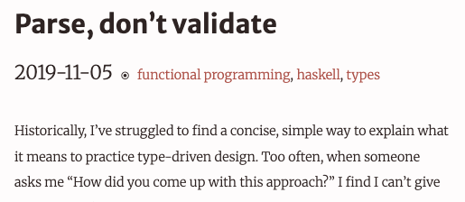
Testing and TypeScript
It makes sense often to treat your TypeScript types as not-needing-to-be-tested
It never makes sense to assume anything about information coming to your server from a REST API call as having the TypeScript type you expect.
Your project is set up so that inputs to REST APIs are treated as unknown, not any.
Don’t use as assertions — validate!
It makes sense sometimes, maybe to treat information coming back to your web app from a server as having the TypeScript type you expect.
https://lexi-lambda.github.io/blog/2019/11/05/parse-don-t-validate/

Slide 20
Testing and TypeScript
What we want is straightforward:
Types the server code understands
Single source of API types
Validators the server can use to sanitize inputs
Readable documentation
Types the client code understands

Slide 21
Testing and TypeScript
What we want is straightforward:
A single place to explain the API interface that produces docs, types, and validators
TSOA
requires writing the API as classes, not as functions
GraphQL
shoves your entire API into one endpoint that accepts HTTP POST requests
has some other advantages we won’t talk about here
Hono
Uses Zod, is interesting! But doesn’t work with express

Slide 22
Review
It’s the end of the lesson, so you should be able to:
Explain the role of “client” and “server” in the context of web application programming
Explain the primary options for client-server communication
Identify places where TypeScript does — and doesn’t! — help with writing correctly-behaving web applications, and identify some of the solutions to functionality TypeScript doesn’t provide

